Slide 1

New York Mets
Midseason Talent Acquisition Strategy
Dashboard Application Guide
NY Mets Confidential

Slide 2
MiLB Prospect Explorer
This dashboard will allow users to quickly find high ranking prospects across a variety of filters and populations. It also allows users to deep dive into a specific prospect to see their stats over their Minor League career.
This guide provides a quick overview of how to use this application in both it’s Desktop and Mobile views.
Application is viewable here: https://public.tableau.com/profile/justin.benson#!/vizhome/MLBEDA/MainPage
NY Mets Confidential

Slide 3
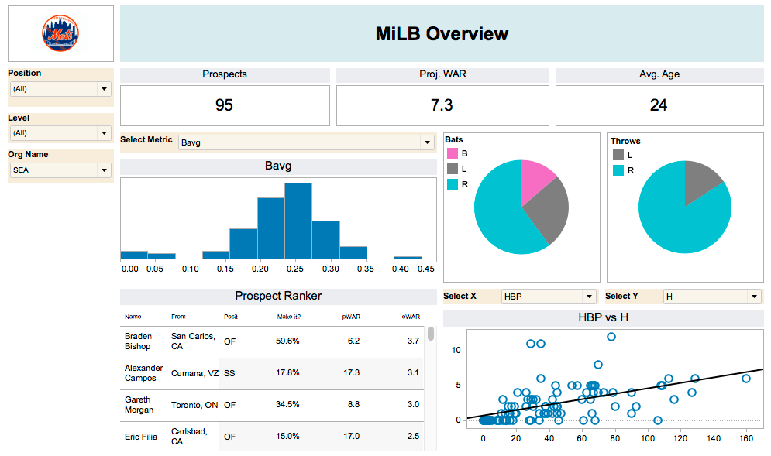
All Orange hued boxes can be used as filters, so you can target prospects from a specific position, level, or organization.
Additionally, the graphs can also act as filters, in case you want to zero in on a specific Batting Avg, handedness or even a specific player from the scatter plot
All actions on this dashboard will help whittle down the prospect ranker to the best prospects from the population you’re interested in. To see more details about that player, simply click on their name.
NY Mets Confidential

Slide 4
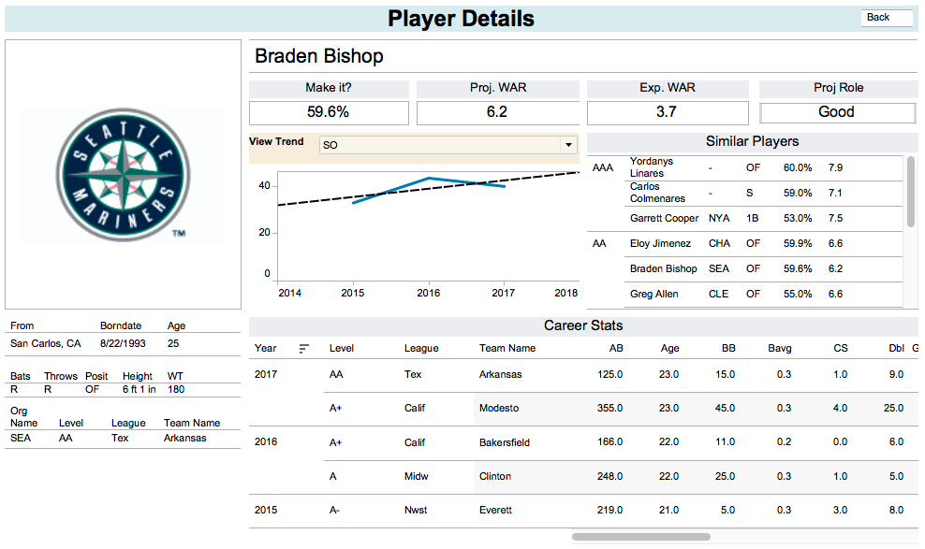
The Player page shows you specific information related to the prospect you’ve selected. You can see their basic bio, current team as well as their projections generated by our models at the top.
You can filter to view specific metrics of theirs over time as well
To return to the main page, click here
Additionally, other similar players based on our model can be seen here
Career stats are shown here and can be scrolled through to see more details
NY Mets Confidential

Slide 5
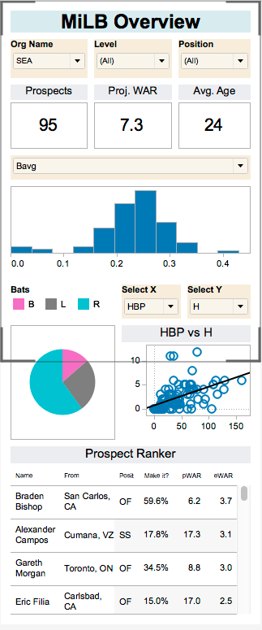
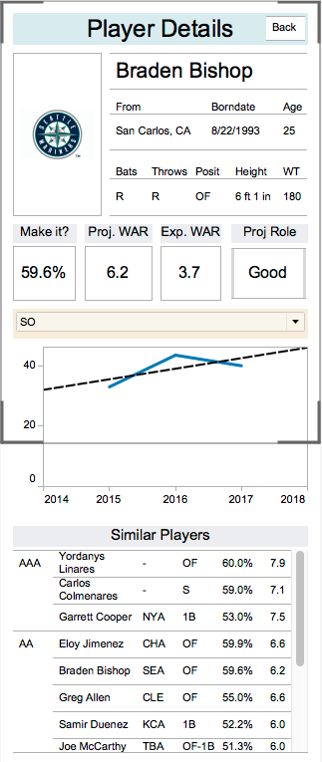
*Simulated screen viewing area*
The Mobile view of the dashboard behaves exactly the same as the desktop version, however it has been optimized for a mobile experience.
You can filter your population down and identify prospects while flying to away games or visiting prospects around the country.
A few of the features present in the desktop version are not available yet in the mobile version (career stats for example are not viewable on a mobile device at this time) but more updates are planned for future releases.
NY Mets Confidential

